Slide 1


<Ibrahim Volpi>
<March 2023>

Slide 2
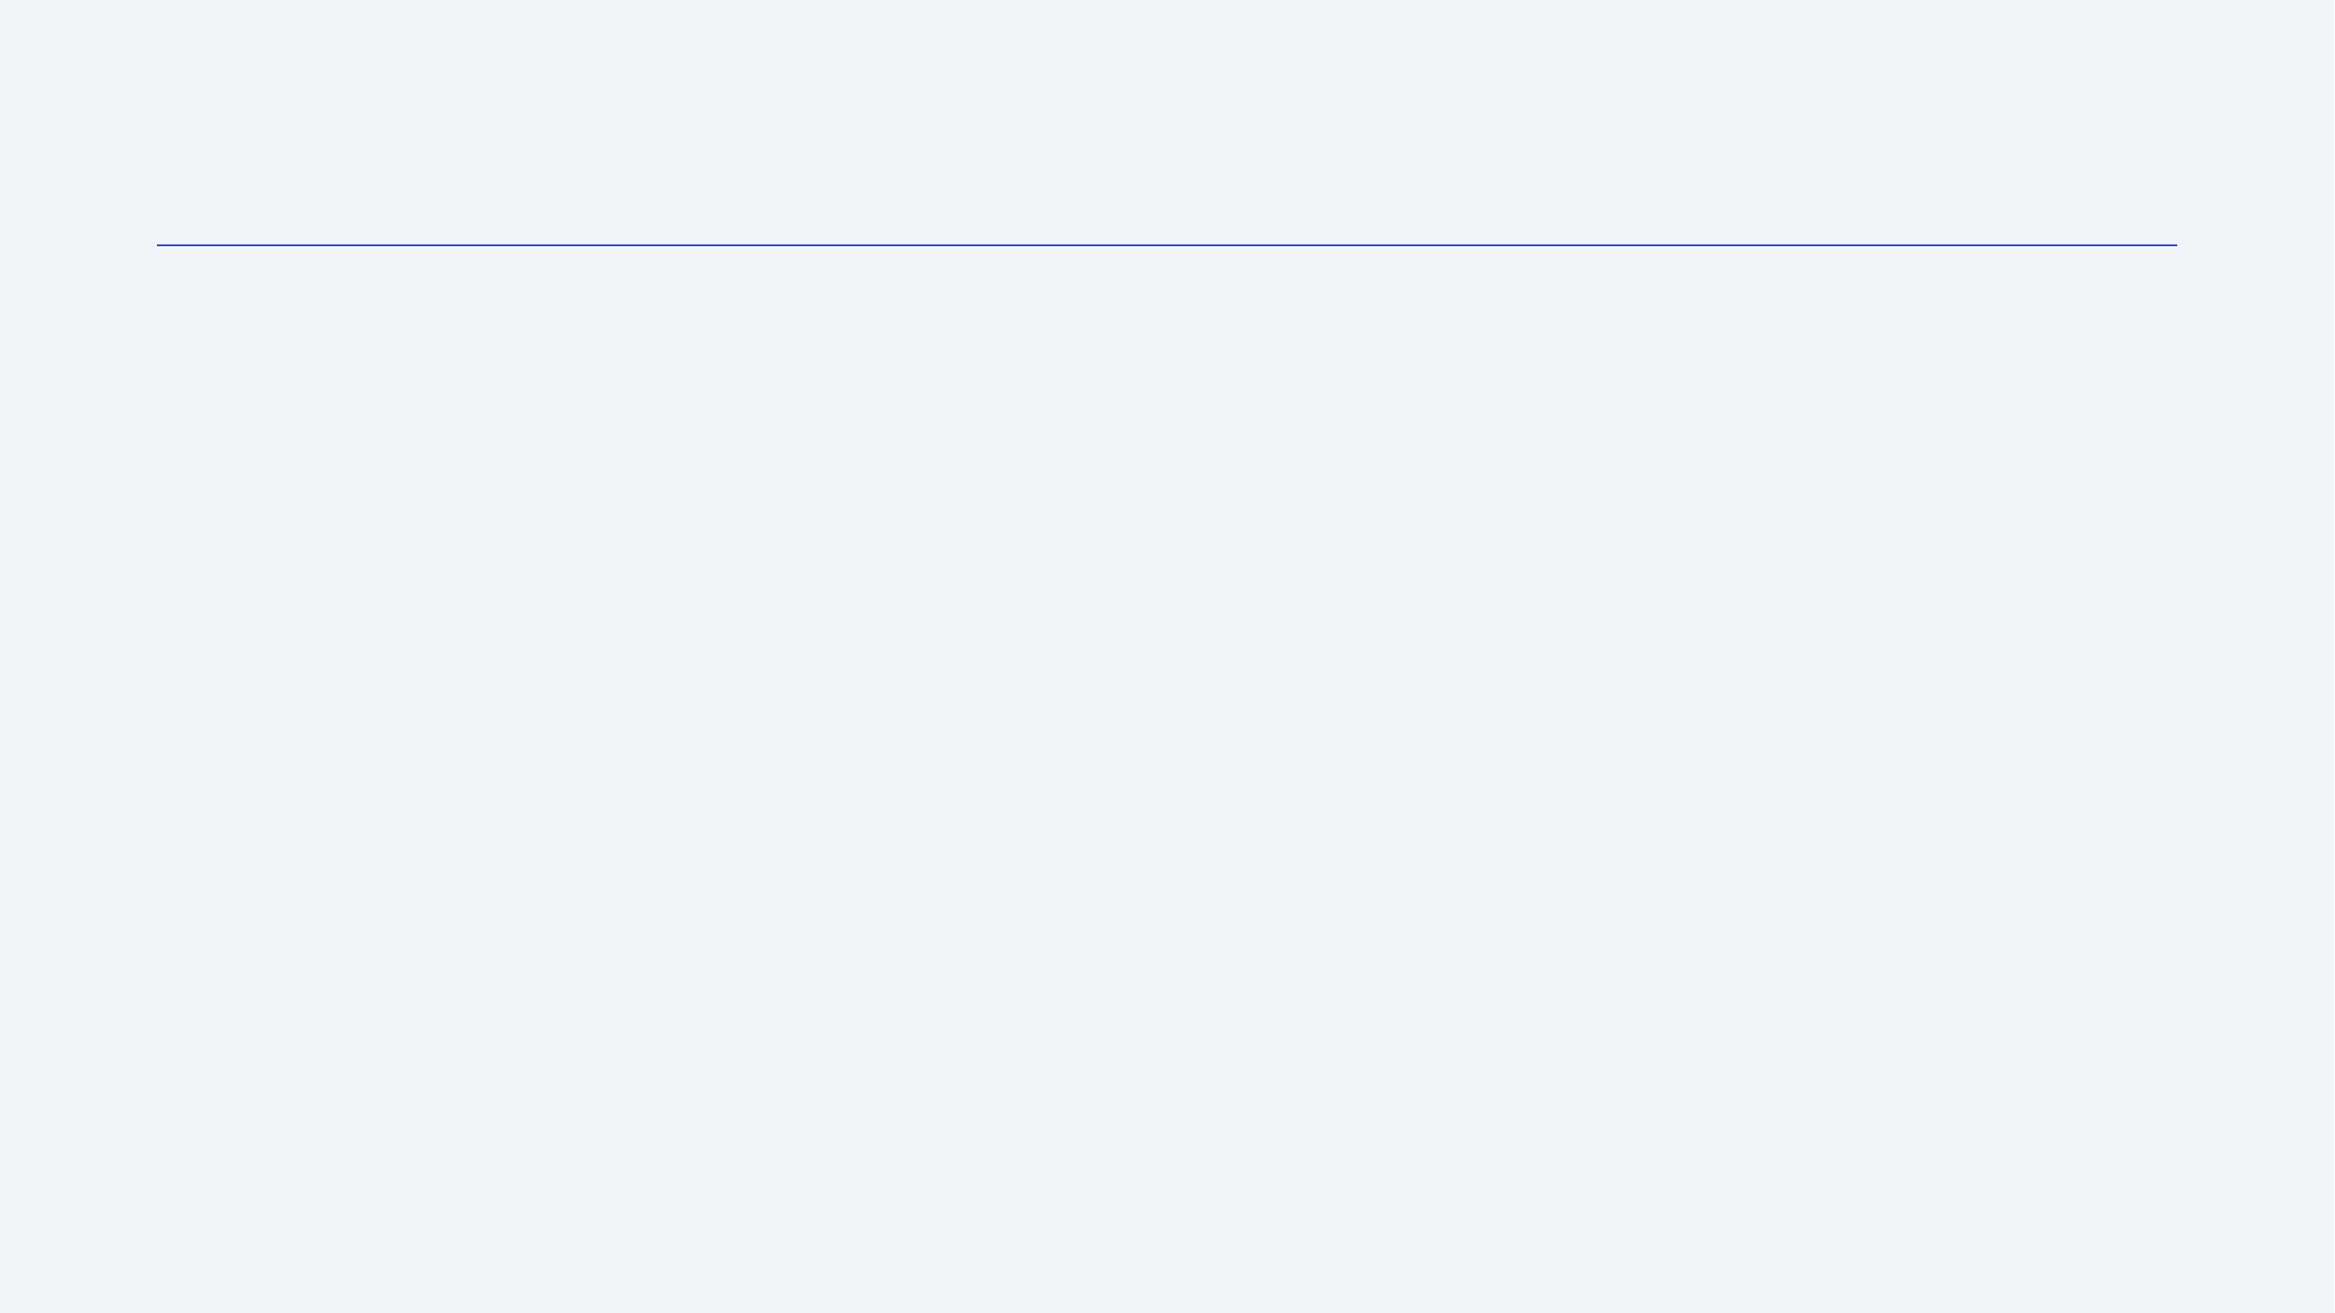
Outline
Executive Summary
Introduction
Methodology
Results
Conclusion
Appendix

Slide 3
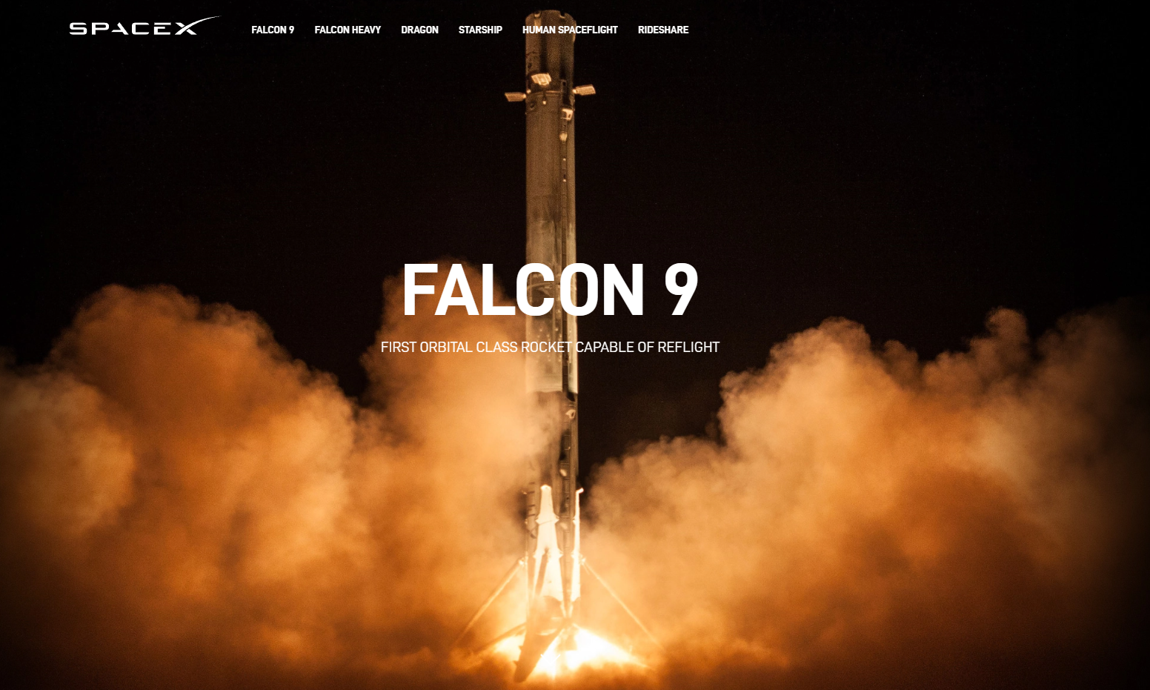
Executive Summary
On this presentation the conclusions extracted after the data collection, wrangling, analysis and model fit will be provided regarding the Success / Failure of launchings for Falcon 9 Orbital Class Rocket activities under SpaceX from four different launch sites.
The EDA and model fit will be processed to gain insight in
terms of the correlation of different variables like Payload mass,
orbit selected, landing site, etc.
Data collection methodology:
Both Web Scraping with “requests” and “BeautifulSoup” packages and the use of the SpaceX API. For consistency on the results, an URL to a JSON file was provided *
Results:
Recommendations regarding decrease on success rates.
Recommendations regarding potential orbits and payload mass with higher success rate
Recommendation regarding best performing launching sites.
https://github.com/IbraTebas/Capstone-Watson/tree/master refer to the MASTER GITHUB branch with all the completed activities.
*https://cf-courses-data.s3.us.cloud-object-storage.appdomain.cloud/IBM-DS0321EN-SkillsNetwork/datasets/API_call_spacex_api.json

Slide 4
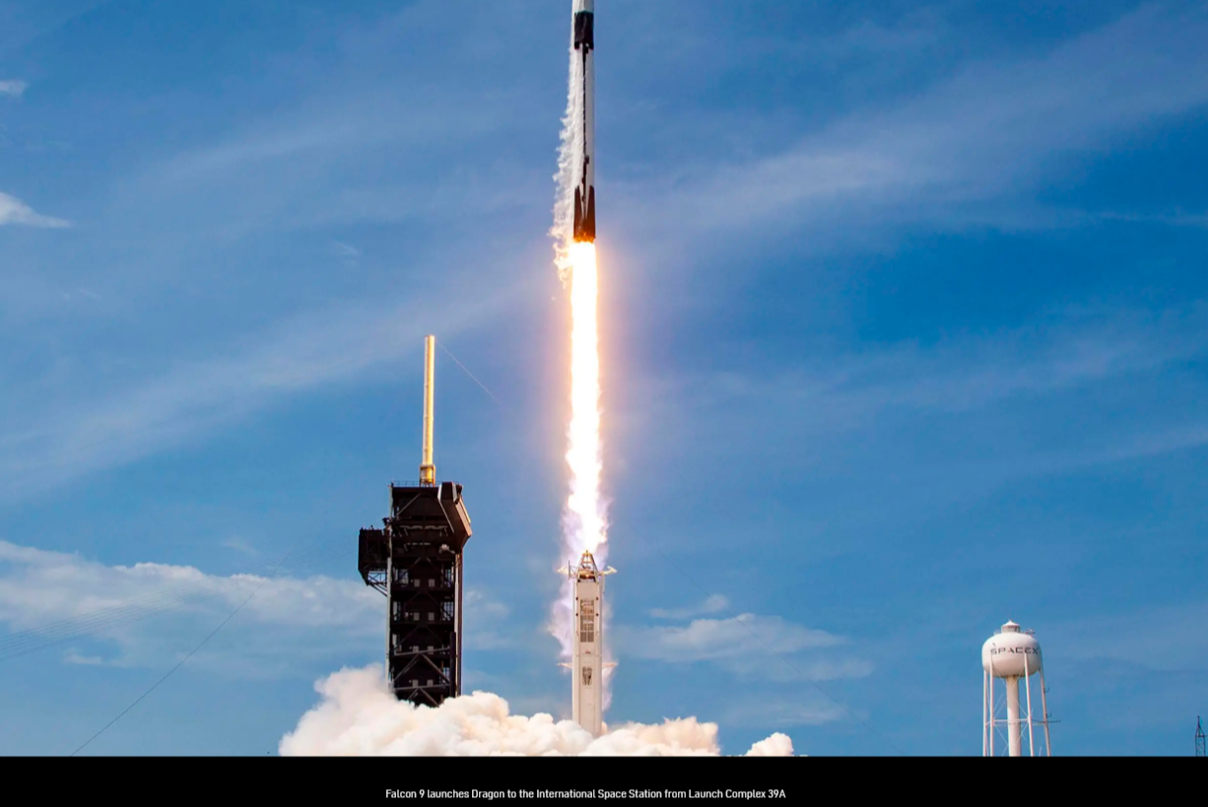
Introduction
This project was developed in the context of the Capstone submission for the IBM Data Science Professional Certificate.
The idea of the project is to gain insight in terms of the Success / Failure of launches for Falcon 9 by SpaceX and the correlation between different variables involved on each launch.
The data provided had multiple sources including Wikipedia URLs, the SpaceX API and JSON files.
The reach of this project is limited as per the volume of data accessed, EDA with visualization and SQL DataBase exploration is included, as well as more interactive exploratory tools as Dashboards
The reach of the conclusions is measured based on the amount of data provided.
Future models and EDAs process with a bigger set of data would be useful in terms of gaining more applicability of the recommendations and insights.

Slide 5

Section 1

Slide 6
Methodology
Executive Summary
Data collection methodology:
Both Web Scraping with “requests” and “BeautifulSoup” packages and the use of the SpaceX API. For consistency on the results, an URL to a JSON file was provided *
Perform data wrangling
Data was selected for FALCON 9 only, missing values were dealt with.
Perform exploratory data analysis (EDA) using visualization and SQL
Perform interactive visual analytics using Folium and Plotly Dash
Perform predictive analysis using classification models
Several models were applied on the standardized one hot encoded Dataframe using the package scikit-learn from Python. The best performance was informed.
*https://cf-courses-data.s3.us.cloud-object-storage.appdomain.cloud/IBM-DS0321EN-SkillsNetwork/datasets/API_call_spacex_api.json

Slide 7
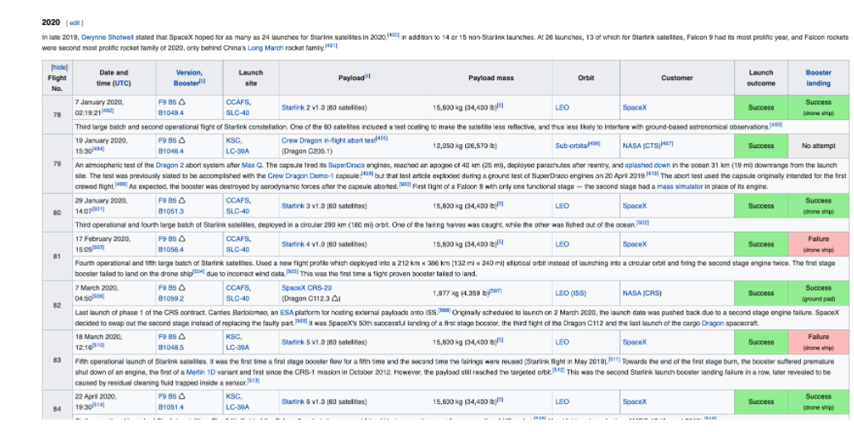
Data Collection
Data collection methodology:
On the first Notebook to be completed : WEEK 1 - Data collection with web scraping, the data was obtained from the website below: https://en.wikipedia.org/wiki/List_of_Falcon_9_and_Falcon_Heavy_launchess
The data was obtained using the Python packages ‘requests’ and ‘Beautiful Soup’
On the second Notebook to be completed: WEEK 1 - Hands-on Lab -Complete the Data Collection API Lab, the data was collected using the SpaceX API and a JSON provided.

Slide 8
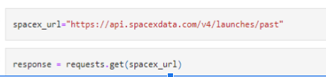
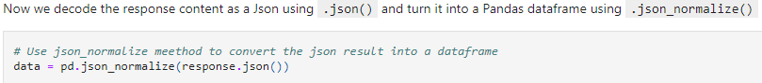
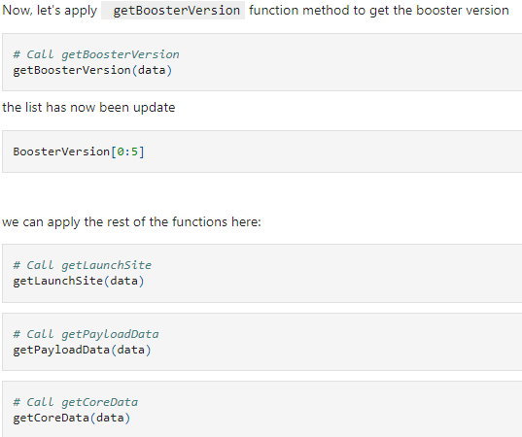
Data Collection – SpaceX API I
Request for data:
GitHub URL of the completed SpaceX API calls notebook
https://github.com/IbraTebas/Capstone-Watson/blob/master/WEEK%201%20-%20Hands-on%20Lab%20-Complete%20the%20Data%20Collection%20API%20Lab.ipynb
Please paste above url in https://nbviewer.org/ to be able to see all the results.
Normalize Json:
Use of several functions to grab the appropriate data:

Slide 9
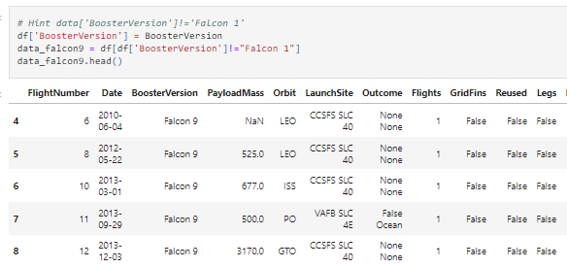
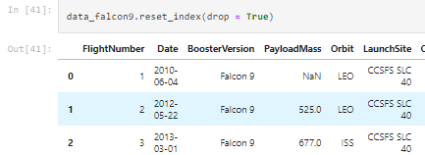
Data Collection – SpaceX API II
GitHub URL of the completed SpaceX API calls notebook
https://github.com/IbraTebas/Capstone-Watson/blob/master/WEEK%201%20-%20Hands-on%20Lab%20-Complete%20the%20Data%20Collection%20API%20Lab.ipynb
Please paste above url in https://nbviewer.org/ to be able to see all the results.
Filtering to keep only Falcon 9 launches:
Reset of the FlightNumber column:

Slide 10
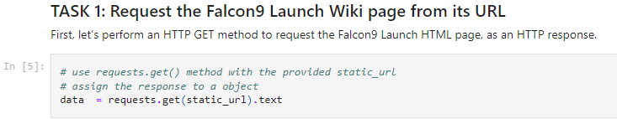
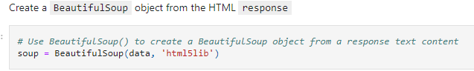
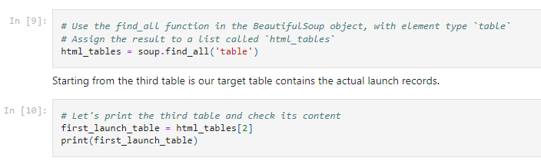
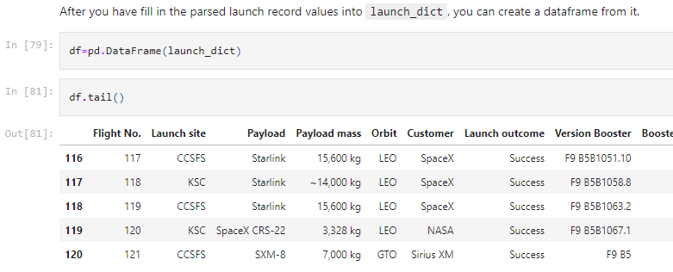
Data Collection - Scraping
Request for data:
Creation of the BeautifulSoup object:
Location and triage of the tables on the Soup object:
Creation of the columns of the future DataFrame and parsing of first_launch_table . Dataframe construction from dictionary.
GitHub URL of the completed web scraping notebook: https://github.com/IbraTebas/Capstone-Watson/blob/master/WEEK%201%20-%20Data%20collection%20with%20web%20scrapping.ipynb
Please paste above url in https://nbviewer.org/ to be able to see all the results.

Slide 11
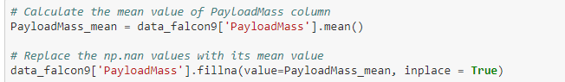
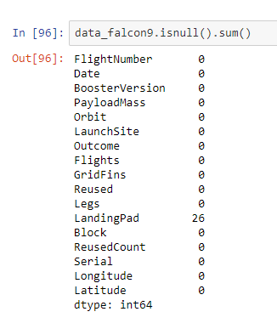
Data Wrangling
NaN values on the LandingPad column were kept as it represents the times the landing pads were not used.
NaN values on the PayloadMass column were filled in with the average of the column
Checked the list of NaN or null values after this transformation, only column showing NaN values would be Landing Pad:
GitHub URL of the completed data wrangling notebook: https://github.com/IbraTebas/Capstone-Watson/blob/master/WEEK%201%20-%20Data%20collection%20with%20web%20scrapping.ipynb
Please paste above url in https://nbviewer.org/ to be able to see all the results.

Slide 12
EDA with Data Visualization
Scatter point charts featuring payload mass and orbits as features were represented with the class variable as hue for the dots represented.
A bar plot regarding the Orbit selected and the Success Rate was processed to understand the correlation between this two variables.
A line plot show was made to show the evolution of the success absolute value through the years.
Notebook: https://github.com/IbraTebas/Capstone-Watson/blob/master/WEEK%202%20-%20Hands%20on%20Lab%20-%20Complete%20EDA%20with%20Data%20Visualization.ipynb
Please paste above url in https://nbviewer.org/ to be able to see all the results.

Slide 13
EDA with SQL
Several queries were processed to the database hosted on IBM Cloud.
This queries include:
Name of launching sites
Booster versions against payload mass
Average payload mass handled
First occurrence of a successful Ground Pad landing
Total number of missions with Success / Failure
Some results by year depending on the outcome.
https://github.com/IbraTebas/Capstone-Watson/blob/master/WEEK%202%20-%20Hands-on%20Lab%20-%20%20Complete%20the%20EDA%20with%20SQL.ipynb completed notebook.
Please paste above url in https://nbviewer.org/ to be able to see all the results.

Slide 14
Build an Interactive Map with Folium
Several activities were processed on Folium maps:
Markers for the landing sites analysed
Markers for Success/ Failed launches for each site.
Distance and lines showing the proximity of one of the launch sites (CCAFS SLC-40) to several points of interest as nearest city, railway, highway and coastline.
https://github.com/IbraTebas/Capstone-Watson/blob/master/WEEK%203%20-%20Hands-on%20Lab%20-%20Complete%20the%20Data%20visualization%20with%20Folium.ipynb GitHub with all activities completed.
Please paste above url in https://nbviewer.org/ to be able to see all the results.

Slide 15
Build a Dashboard with Plotly Dash
5 different types of piecharts were added to the Dashboard, showing the success rate of each launch site in particular and also in comparison all of them together. The selection of each site or the option “All Sites” is actioned by the user with a drop down menu.
Scatter plots were added taking into considerations the variables of payload mass, the success or failure (class) and also the Booster Version used. The user has the ability to adjust the payload mass interval variable using a slider.
Refer to https://github.com/IbraTebas/Capstone-Watson/blob/master/WEEK%203%20-%20Hands-on%20Lab%20-%20Build%20an%20Interactive%20Dashboard%20with%20Ploty%20Dash.ipynb complete notebook reporting the above.

Slide 16
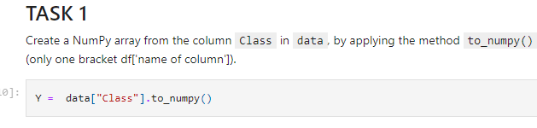
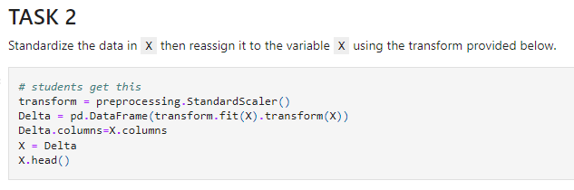
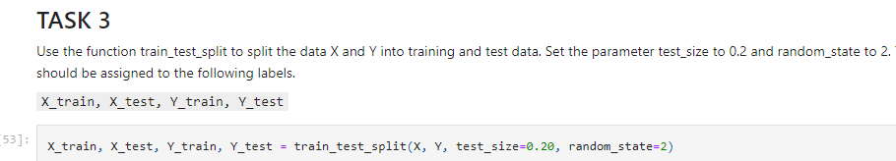
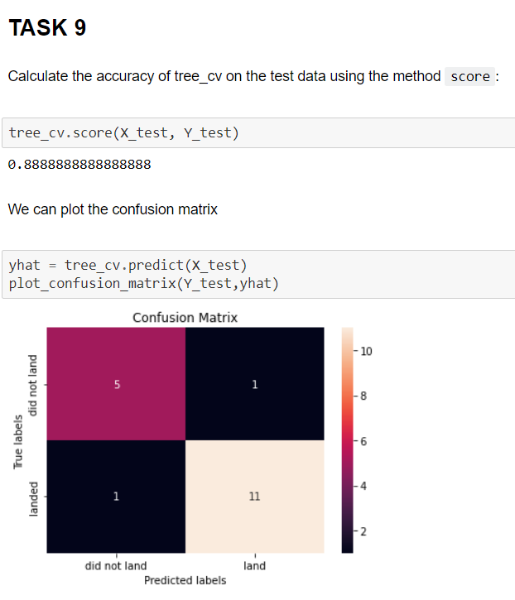
Predictive Analysis (Classification)
The data is loaded from two CSV files provided to make the results similar to all students.(*)(**)
“Class” column in one of the two datasets is converted to a numpy array to be used as train and test Y set.
Data for the train and test X set is Normalized.
A test/test partition of the data is created.
Several models are fit using GridSearchCV with cv = 10
Accuracy and score is measure and confusion matrix provided.
Best predictor classifier is stated as Tree Classifier based on the results.
https://github.com/IbraTebas/Capstone-Watson/blob/master/Week%204%20-%20%20Hands-on%20Lab%20-%20Machine%20Learning%20Prediction%20lab.ipynb GitHub with all the activities completed.
Please paste above url in https://nbviewer.org/ to be able to see all the results.
*https://cf-courses-data.s3.us.cloud-object-storage.appdomain.cloud/IBM-DS0321EN-SkillsNetwork/datasets/dataset_part_2.csv
**https://cf-courses-data.s3.us.cloud-object-storage.appdomain.cloud/IBM-DS0321EN-SkillsNetwork/datasets/dataset_part_3.csv'

Slide 17
Results
Results:
Regarding the success rate evolution through years:
The launch success rate had diminished since 2020 in terms of the records analysed.
Recommendations regarding potential orbits and payload mass with higher success rate:
VLEO shows as a strong candidate with 85% success rate.
Payload masses between 3000 kg and 4000 kg seem to have a much better performance (70% success)
Recommendation regarding best performing launching sites.
KSC LC 39A (Kennedy Space Center Launch Complex 39A) has the best performance in terms of absolute amount of successful landings and in terms of success rate.

Slide 18

Section 2

Slide 19
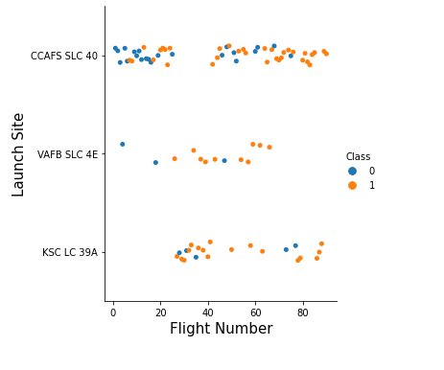
Flight Number vs. Launch Site
Insights:
Both VAFB SLC 4E and KSC LC 39A have a better success rate than CCAFS SLC 40
CCAFS SLC 40 improves their success rate greatly after flight number 60 and onwards.
VABF SLC 4E has had significantly less flights than the other two sites.

Slide 20
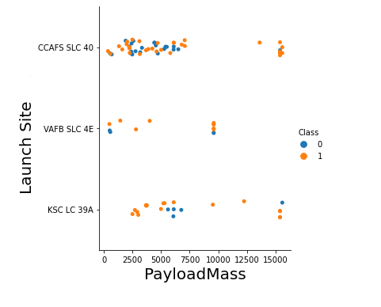
Payload vs. Launch Site
Insights:
Barely no launches are processed for values of payload mass between 7500 and 12500 Kg, and none on site CCAFS SLC 40
CCAFS SLC 40 has the largest amount of heavy payload mass launches successful.
VABF SLC 4E has not processed any lunches for heavy payload mass (greater than 10,000 KG)

Slide 21
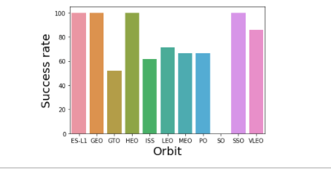
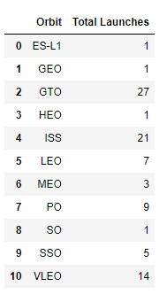
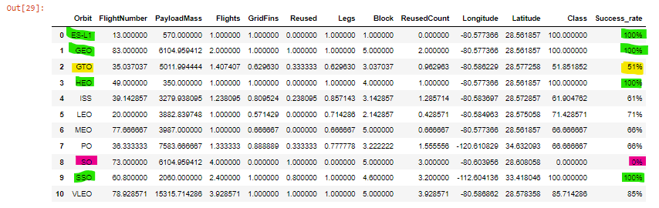
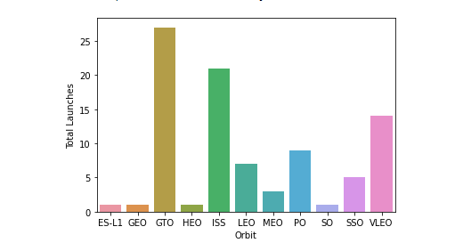
Success Rate vs. Orbit Type
Insights:
The success rate for orbit SO is 0% but only one launch was attempted.
The orbit with less success rate is GTO with 51% success rate.
ES-L1, GEO, HEO and SSO orbits shows a 100% success rate but very few launches.
Taking into consideration that the orbits more used are GTO, ISS and VLEO in that order, VLEO shows as a strong candidate with 85% success rate.

Slide 22
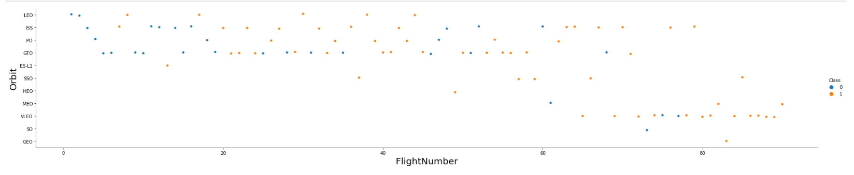
Flight Number vs. Orbit Type
Insights:
LEO Orbit: the success seems to be correlated to the flight number.
GTO orbit: the success does not seem to be correlated to the flight number ( keeps on altering colors)

Slide 23
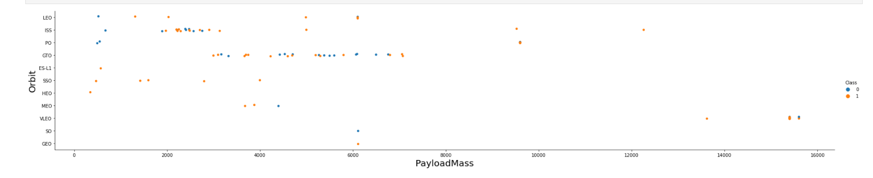
Payload vs. Orbit Type
Insights:
POLAR, LEO and ISS orbits: heavy payloads seem to be successful more frequently.
GTO orbit: the alternancy of the success and failure seems to not be correlated to payload mass.

Slide 24
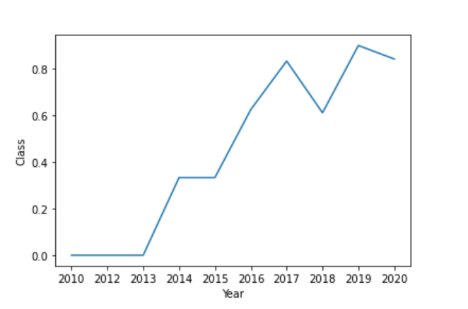
Launch Success Yearly Trend
Insights:
The success rate had mostly increased since 2013 until 2020.
The success rate seems to diminish after 2020.

Slide 25
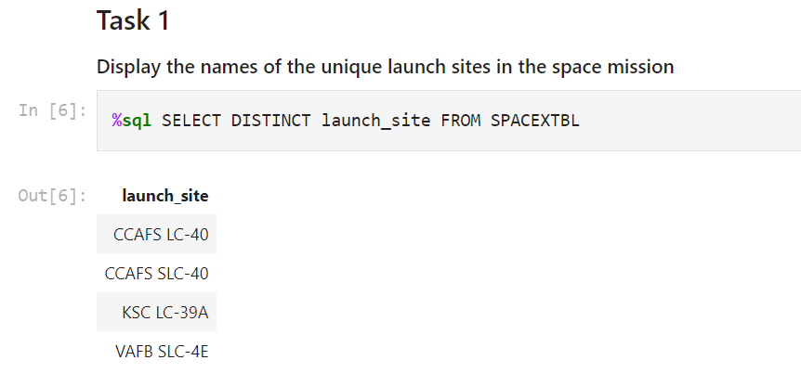
All Launch Site Names - SQL Query
The “SELECT DISTINCT” part of the query provides the categories of the variable.

Slide 26
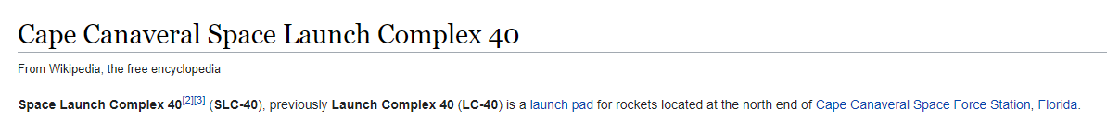
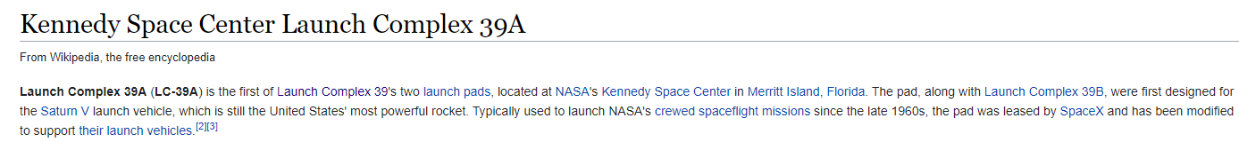
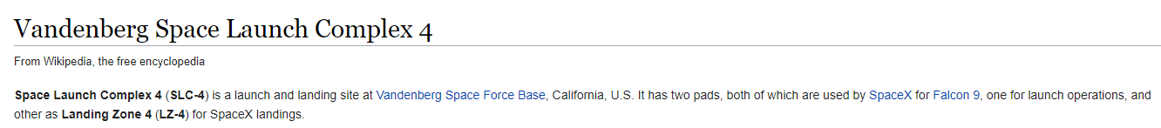
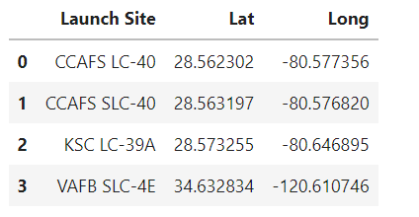
All Launch Site Names - Further information
https://en.wikipedia.org/wiki/Cape_Canaveral_Space_Launch_Complex_40
https://en.wikipedia.org/wiki/Kennedy_Space_Center_Launch_Complex_39A
https://en.wikipedia.org/wiki/Vandenberg_Space_Launch_Complex_4
Codes and coordinates (Lat = Latitude // Long = Longitude) for the launch sites analysed.
Refer to top Wikipedia article regarding the full name of each launch site.

Slide 27
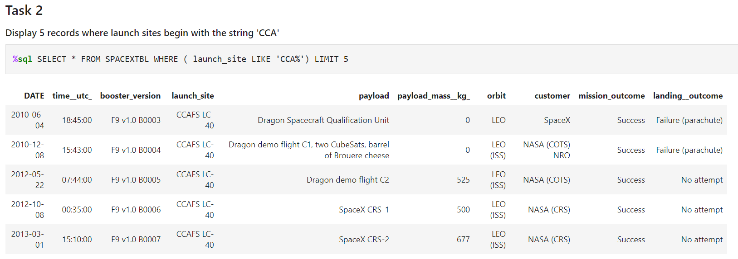
Launch Site Names Begin with 'CCA'
The “LIKE ‘CCA%” sets the condition and the “LIMIT” the amount to display on this query.

Slide 28
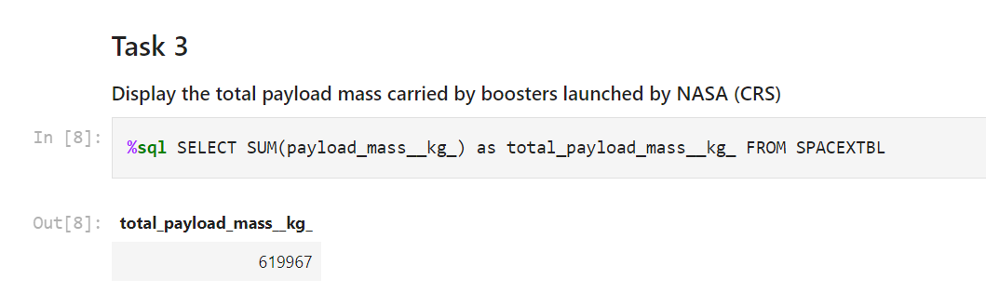
Total Payload Mass
“SUM” process the query as an addition of the variable indicated.

Slide 29
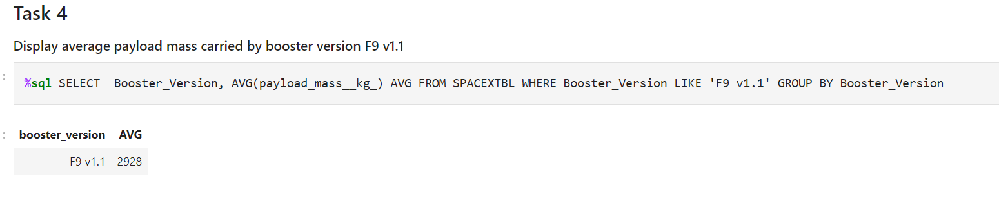
Average Payload Mass by F9 v1.1
“AVG” process the average, the “LIKE” part filters the Booster Version

Slide 30
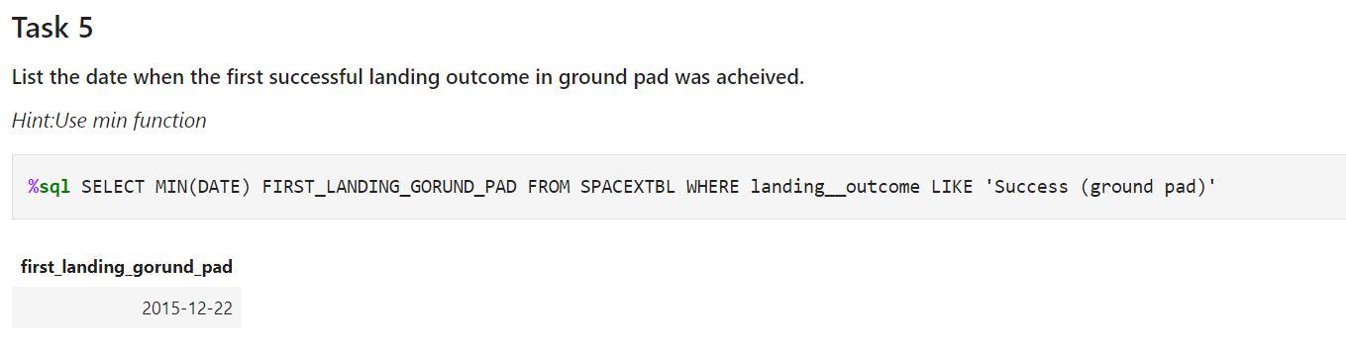
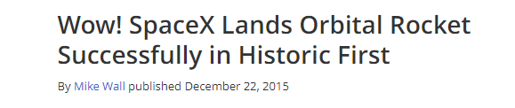
First Successful Ground Landing Date
Article header extracted from “https://www.space.com/31420-spacex-rocket-landing-success.html”

Slide 31
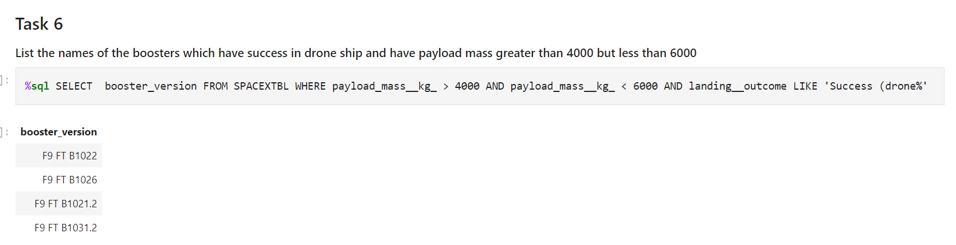
Successful Drone Ship Landing with Payload between 4000 and 6000
In this query two “AND” were needed, as the condition implies to be lesser than a number and greater than other and also with a specific outcome ( three conditions to impose on the WHERE)

Slide 32
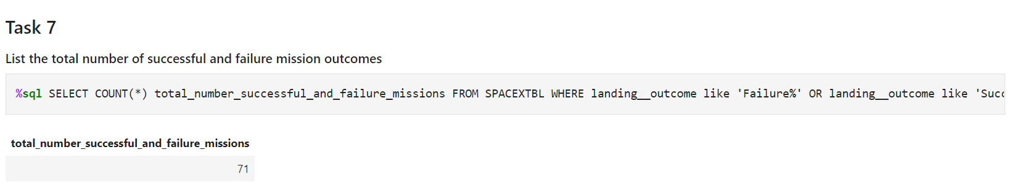
Total Number of Successful and Failure Mission Outcomes
‘COUNT’ is used here to provide the total required, the ‘WHERE’ is applied to the landing__outcome category with both options of Success or Failure with the use of the “%”

Slide 33
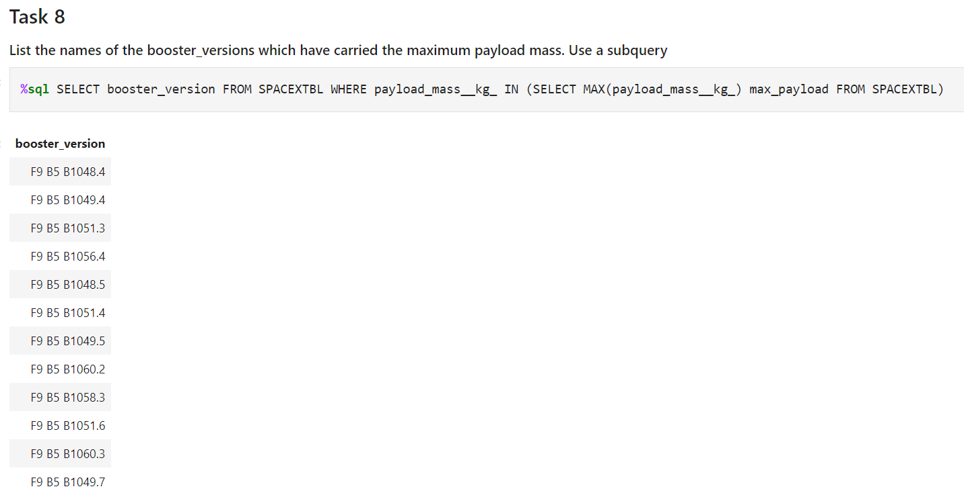
Boosters Carried Maximum Payload
The subquery resolves with the MAX obtains the maximum payload to then filter the Booster Versions were the maximum payload was attempted.

Slide 34
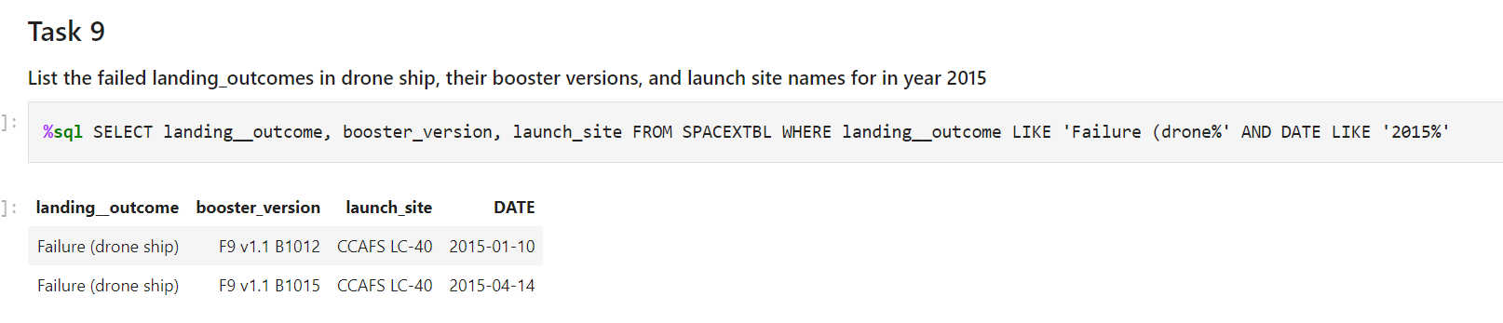
2015 Launch Records
Two records are displayed when the year is filtered to 2015 using the “%” wildcard, and the condition of a Failure (drone ship) scenario is imposed.

Slide 35
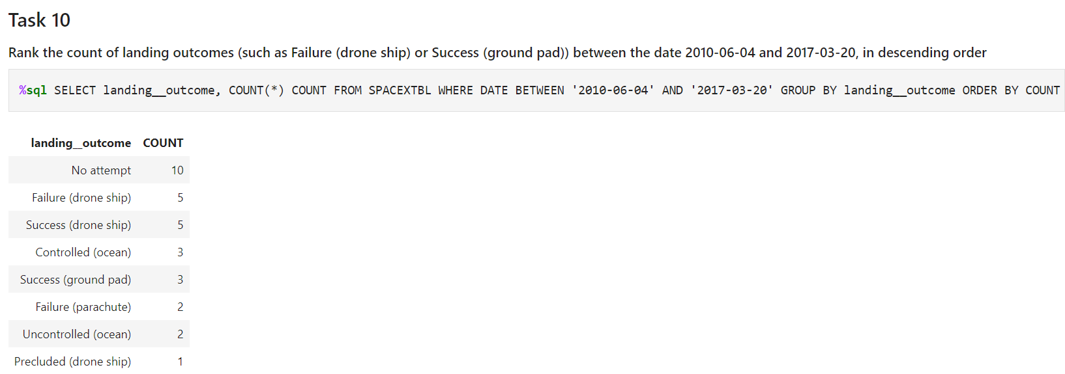
Rank Landing Outcomes Between 2010-06-04 and 2017-03-20
Based on the fact that in a previous part was established that the first successful landing in Ground Pad was the 22nd December 2015, it means that this feat was repeated another two times between the 22nd December, 2015 and the 20th March, 2017

Slide 36

Section 3

Slide 37
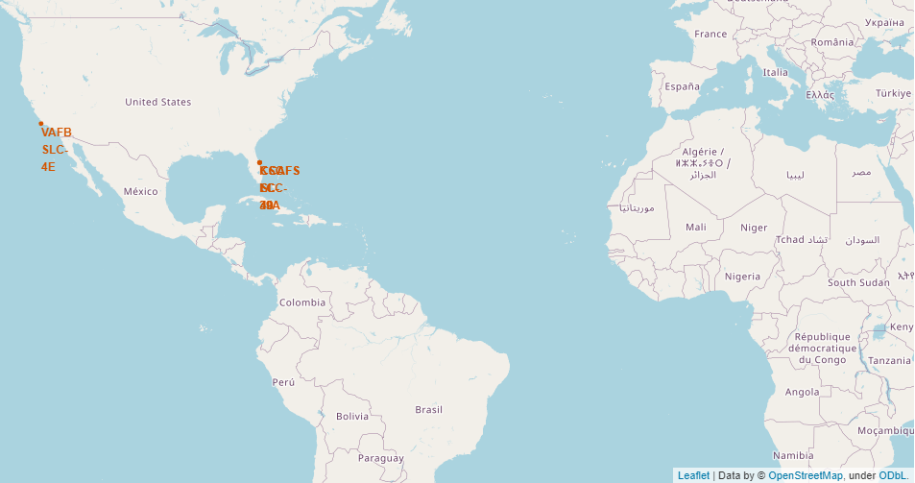
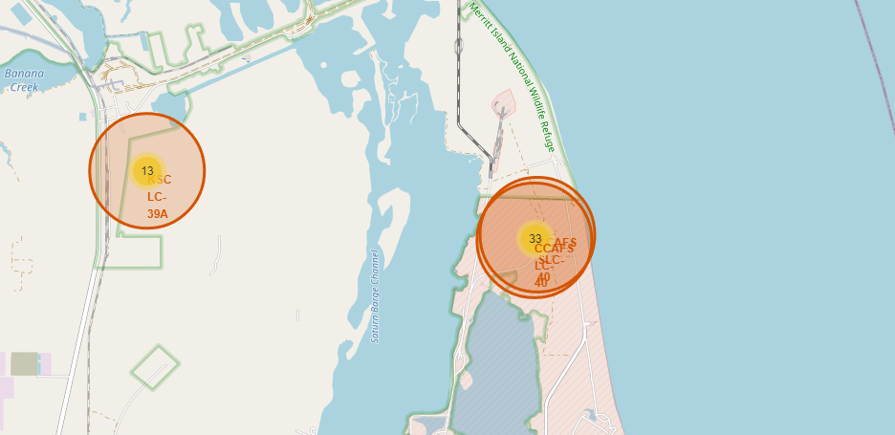
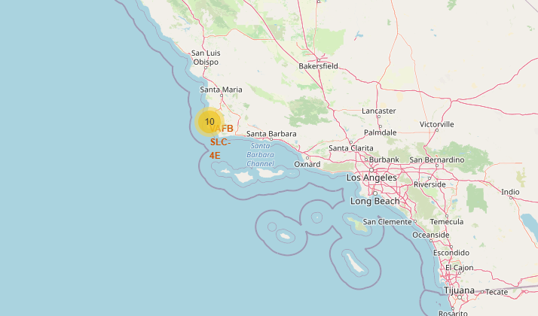
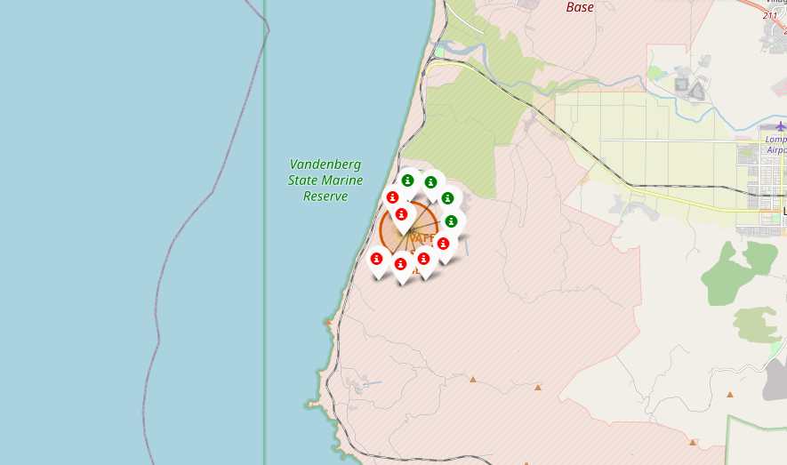
Location of the launching sites - Map I
CCAFS SLC-40 is the name update to the launch site named before CCAFS LC-40, therefore this references are mostly in the same position on the map, very near of the KSC LC-39A launch site as well.
The launch site VAFB SLC-4E is located on the West Coast and only 10 records from that launching site are analysed on this report.
It is visually clear there is slightly more Failures than successes on the 10 records analysed.

Slide 38
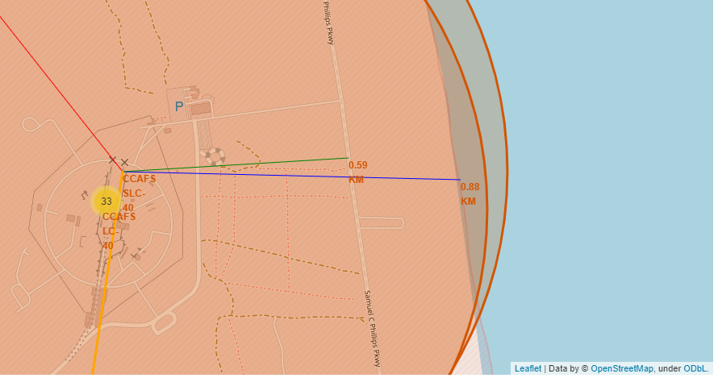
Distance from CCAFC SLC-40 to the coast and highway
Both the distance to the highway (in green) and to the coast from CCAFC SLC-40 is lesser than 1 km.

Slide 39
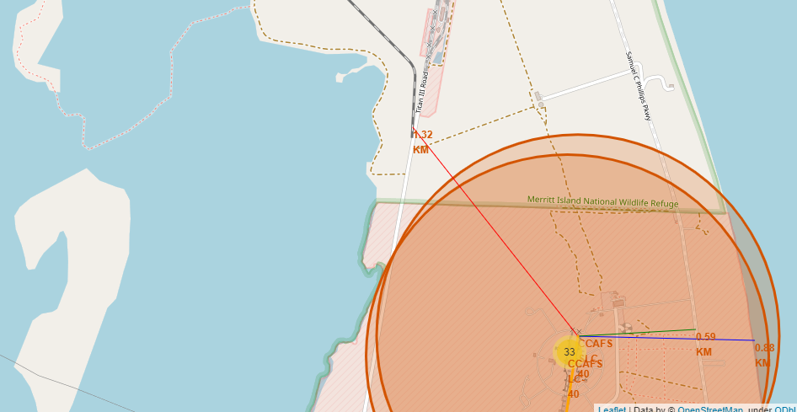
Distance from CCAFS SLC-40 to the railway
In terms of access to railway, the access is located 1.8 km North-West from the CCAFS SLC-40 launch site.

Slide 40
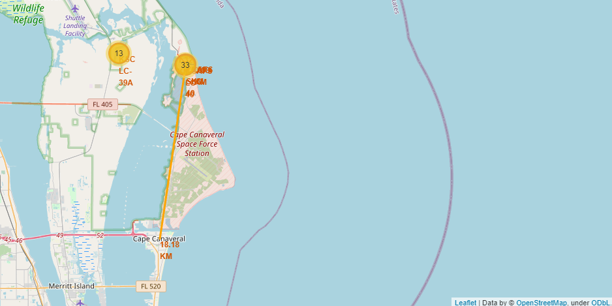
Distance from CCAFS SLC-40 to the nearest city / town.
The nearest city is located South from the launching site CCAFS SLC-40, about 18.18 km
The name of the city is Cape Canaveral.

Slide 41

Section 4

Slide 42

Selector using “All Sites option, no range filter applied with the Payload Range slider.

Slide 43

Selector using “All Sites” option, range filter applied with the Payload range slider between 3000 kg and 7000 kg
If we compare this scatter plot and the previous one, it can be observed the change on the scale of the “x” axis and also the change on the dots displayed.
It is also visible that the selected range in the slider is highlighted in light blue.

Slide 44

Selector using site “KSC LC-39A” option, no range filter applied with the Payload Range slider.
This is by far the site with the best success rate.

Slide 45

Selector using site “KSC LC-39A” option, range filter applied with the Payload Range slider between 4000 kg and 10,000 kg.
Seems like the effectiveness drop the higher the payload for this launching site.

Slide 46


Some insight gained with the manipulation of the dashboard.

Slide 47

Section 5

Slide 48


Classification Accuracy
The model with the best accuracy is Tree Classifier when combined with GridsearchCV with cv = 10 as instructed.

Slide 49

Confusion Matrix - Tree Classifier
On this attempt the score obtained by the Tree Classifier was 88.89%, in 18 predictions against the test set, only two mistakes.
One mistake on the prediction against the test: it was predicted that would not land and it landed (number one on the left down black square)
Another mistake on the prediction: it was predicted that would land but it didn’t (top right black square with a number 1).

Slide 50
Conclusions
The launch success rate had diminished since 2020 in terms of the records analysed, a review on changes done since then would be relevant to understand the change on the tendency.
KSC LC 39A (Kennedy Space Center Launch Complex 39A) has the best performance in terms of absolute amount of successful landings and in terms of success rate.
An audit of the processes followed there would be beneficial to provide insight to less performers like CCAFS SLC 40 (Cape Canaveral Space Launch Complex 40)
Taking into consideration that the orbits more used are GTO, ISS and VLEO in that order, VLEO shows as a strong candidate with 85% success rate, considering the reduced data analysed. GTO is used the most but have the lesser success rate, a revision in terms of VLEO orbit usage as a strong candidate should be considered if technically possible.
Payload masses between 3000 kg and 4000 kg seem to have a much better performance (70% success)
The Tree Classifier model trained seems to have a good performance (88.89% accuracy) but the amount of records used to trained the model was too small, so overfitting is a risk with this data size.
In order to have a more valuable classifier predictor, more records should be added to the clean data to be able to train the model with a bigger set.

Slide 51


